Slide 1
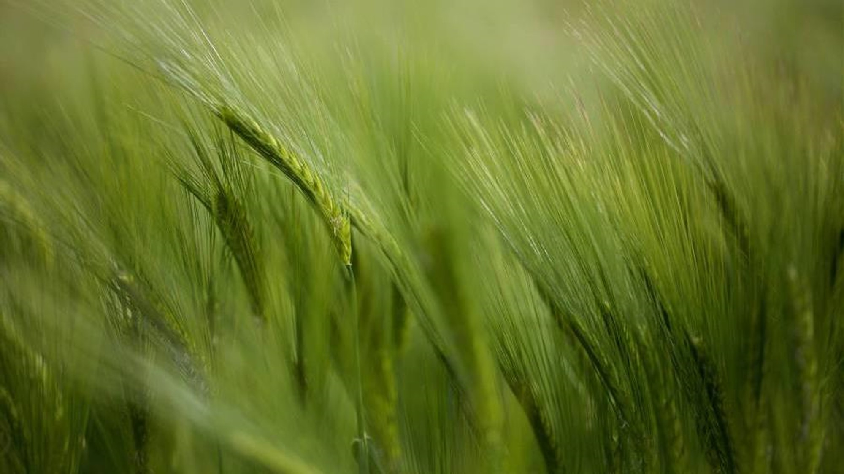

Predicting pleasant days
ClimateWins
Using Machine Learning
for predicting the weather
October 14, 2025
Data Analyst: Ratul Debnath

Slide 2

Table of content
ClimateWins
1. Project Objective
2. Training Models
3. Understanding the Data
4. Analytics
5. Recommendations

Slide 3
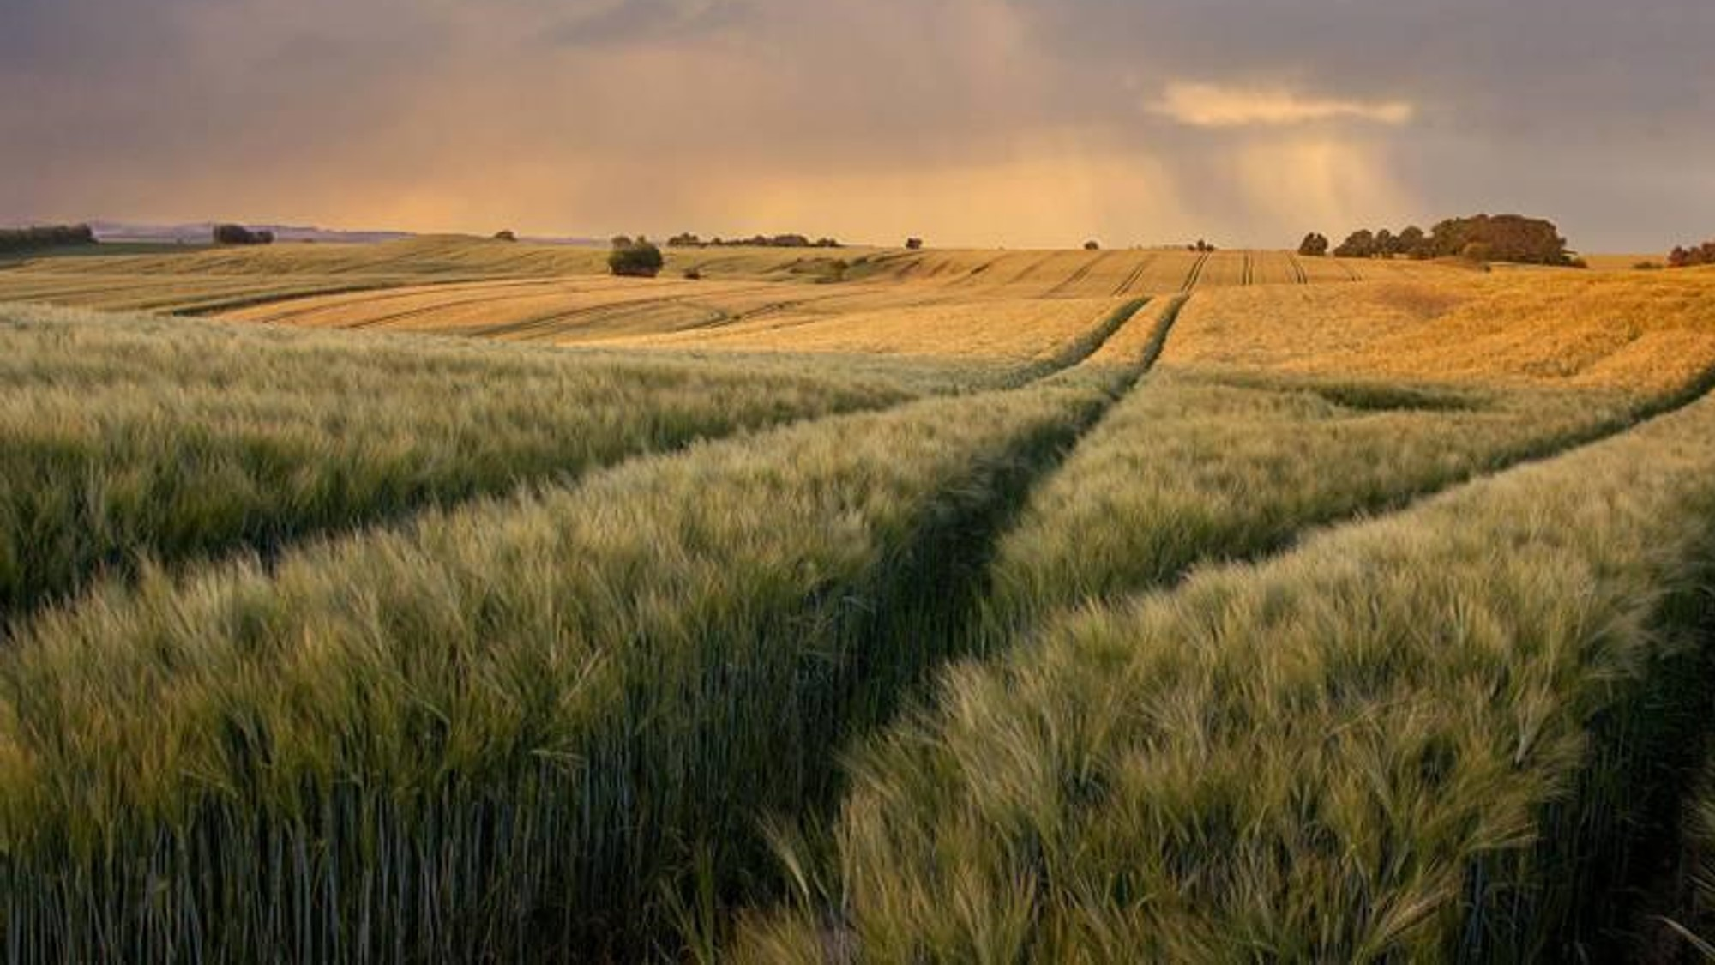
Objective
ClimateWins

Slide 4
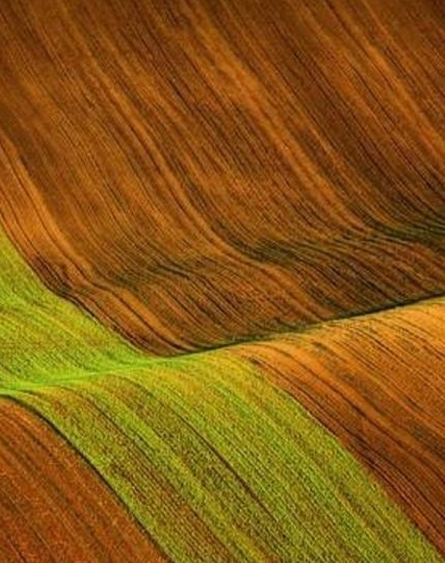
1. Build and present a ML approach that helps ClimateWins forecast weather-related outcomes to guide decisions. 2.Business framing: reduce costly misclassifications of 'pleasant' vs 'unpleasant' conditions Deliver: clear model, evaluation, risks, and next steps for deployment

Slide 5
Training models
ClimateWins
Ethical Use of ML
Machine learning helps analyze climate patterns but risks harm if misapplied. Sensitive inputs (e.g., household energy use, locations) can expose privacy or socioeconomic status. Data skewed toward wealthier regions embeds regional, economic, and cultural bias, neglecting vulnerable communities. Human labeling and prior research can further propagate assumptions, shaping flawed predictions. Oversimplified or incorrect forecasts (droughts, floods, heat waves) may misguide policy and funding, hurting those most at risk. ClimateWins should center transparency, fairness, and strong data-privacy practices in all ML work.
There are three models that were trialed to find the most optimal approach:
KNN: Predicts from the k closest examples (vote/average); simple but sensitive to scaling and can be slow on big data.
Decision tree: Splits data by feature thresholds into a flowchart; interpretable but prone to overfitting without depth/pruning.
ANN: Layers of neurons learn non-linear patterns via gradient descent; powerful but data-hungry and tuning-intensive.

Slide 6
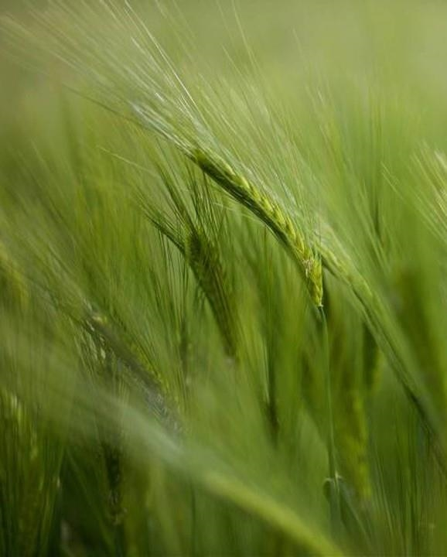
The Data
Source, Biases, Accuracy

Slide 7
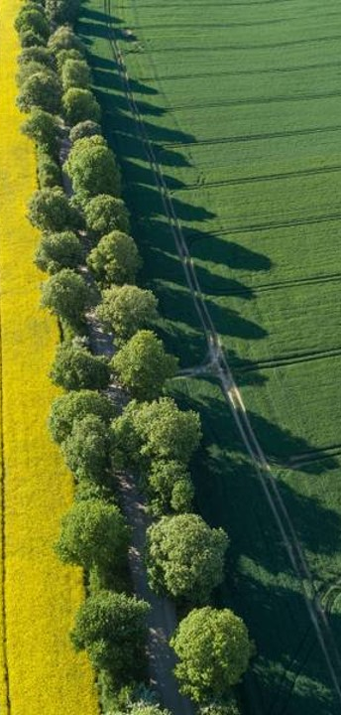
Source The data has been provided by climate wins. It is sourced from their weather stations across Europe over five decades.
BiAs
Coverage bias: stations could be unevenly distributed across terrain/altitude
gaps: missing readings and sensor outages
Labeling bias: human-defined 'pleasant' may vary by region/culture/season
Data accuracy
There are many factors that could affect data accuracy:
calibrated sensors
QC filters
outlier checks
imputation summary
Recommendations
The recommendations are based on analytic data as well as observations made when working with the ml model

Slide 8

Analytics
With the given dataset, the ANN model of ML was the most accurate (65% training accuracy), although it is a resource hungry process. The Decision Tree was a close second (58% training accuracy) and the KNN model was a distant third (50% training accuracy).

Slide 9
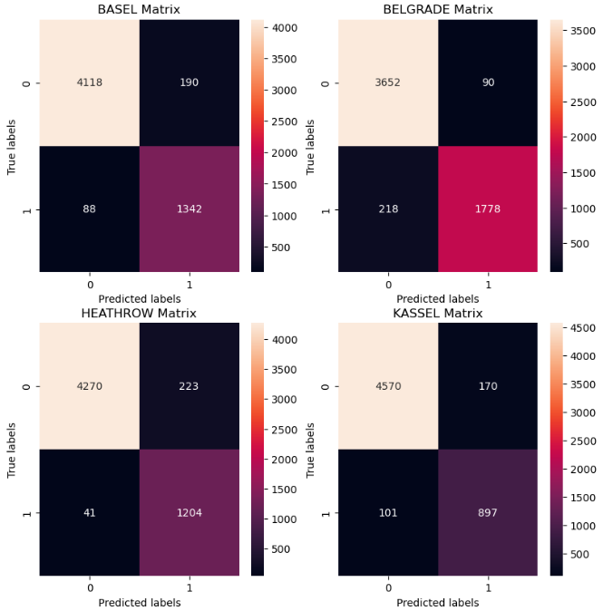
Ann model
Looking at a small sample size of unpleasant vs pleasant using the ANN model shows that about 23.4% of days in Basel are pleasant. Belgrade on the other had is 31%.

Slide 10
ANN Model
Madrid shows to have the highest percentage of pleasant days at 42.3%. Kassel in Germany shows to be the lowest at 15.7%. Both seem accurate. Sonnblick and Valentia seem to be overfitting and underfitting respectively, so will be disregarded from analysis.

Slide 11
Ann model
Weather Station | CORRECT |  | FALSE -VE | FALSE +VE | ACCURACY
BASEL | 4118 | 1342 | 88 | 190 | 90.3%
BELAGRADE | 3652 | 1778 | 218 | 90 | 89.3%
BUDAPEST | 3715 | 1775 | 77 | 171 | 91.4%
DEBILT | 4393 | 944 | 193 | 208 | 86.0%
DUSSELDORF | 4374 | 1085 | 168 | 112 | 90.2%
HEATHROW | 4270 | 1204 | 41 | 223 | 90.8%
KASSEL | 4570 | 897 | 101 | 170 | 90.6%
LJUBLJANA | 3840 | 1580 | 10 | 308 | 88.9%
MAASTRICHT | 4384 | 1080 | 120 | 154 | 90.4%
MADRID | 3112 | 2425 | 126 | 75 | 93.0%
MUNCHENB | 4386 | 1052 | 145 | 152 | 89.6%
OSLO | 4467 | 899 | 34 | 338 | 87.0%
SONNBLICK | 5738 | 0 | 0 | 0 | 100.0%
STOCKHOLM | 4481 | 963 | 14 | 280 | 89.8%
VALENTIA | 5356 | 192 | 119 | 71 | 93.4%
 |  |  |  | AVERAGE | 90.7%
The ANN model on this dataset can accurately predict whether the day will be pleasant or not with a ~91% accuracy. This is incredibly high given the unpredictability of whether. Especially in Northern and Eastern Europe.

Slide 12
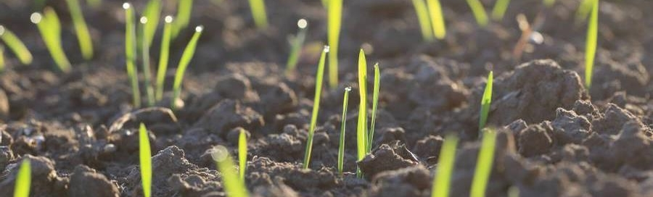
Recommendations
Model Choice:
Lead with ANN, keep Decision Tree as a fallback.
Stabilize Training:
Standardize scaling
Tuning:
Further tuning is required to reduce the false negatives and false positives.
Definition Clarity:
Define “pleasant day” with stake holders.
Stabilize Training:
Standardize scaling
Add Features:
Add Lags, rolling stats, seasonality
Bias:
Audit Coverage gaps, ensure data collecting equipment is maintained and calibrated.
Stabilize Training:
Standardize scaling
Delivery:
Simple Dashboard for daily monitoring

Slide 13

Thank you
Ratul Debnath​​
705-970-0224​
https://github.com/ratul-debnath/ML-Pt-1-WeatherStations

